Slide 1





ONLINE SHOP CUSTOMER SALES ANALYSIS
Presented by Group 5:
Tara Maya Limbu [07230078]
Bishnu Kumari Karki [07230003]
Pema Wangdi [07230074]
Sonam Chophel [07230061]

Slide 2


Content
01
Data Cleaning and Preprocessing
02
Data Visualization and Analysis
03
Model Building
04
Model Prediction Using Unseen Data
05
Conclusion

Slide 3

Data Cleaning and preprocess
Handling Missing & Inconsistent Values
- No null values found, but some columns (e.g., 'Gender', 'Browser') had inconvenient or
empty entries.
- Default values assigned: ‘Gender ‘- 0 for Male, 1 for Female; ‘Browser ‘ -3 for 'Other'.
- Ensured dataset consistency by replacing inconsistencies with appropriate defaults.
Preprocessing Steps
- Checked the total number of rows and columns (Dataset: 65,796 rows × 12 columns).
- Checked data types: 2 floats, 9 ints, 1 object.
- Cleaned and converted purchase_DATE to datetime format.
- Categorized Age into meaningful Age_Group labels.

Slide 4

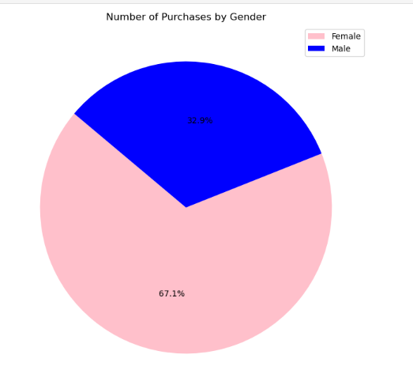
2. Data Visualization and Analysis
2.1 Purchases by Gender (Pie Chart
- 67% of purchases from females, 33% from males.
- Indicates a larger female customer base.

Slide 5

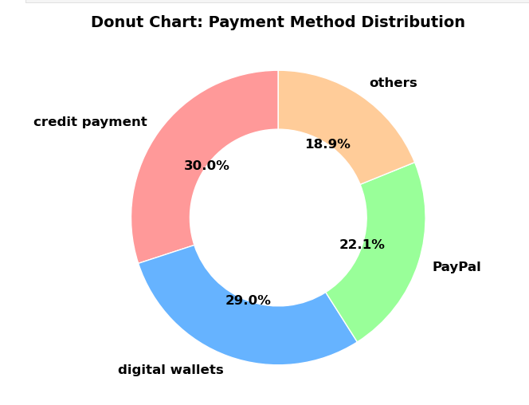
2. Data Visualization and Analysis
2.2 Donut Chart
According to the chart, transaction made by credit payment is 30%, then PayPal with 22.1%, digital wallets with 29%, and payments made through other means are 18.9%.

Slide 6


3. Model Building
Models
Initial Model: Linear Regression (Scikit-Learn)
Improved Model: Gradient Boosting Regression
Features: 'N_Purchases', 'Gender', 'Pay_Method'.
Performance:
R² ≈ 0.515,
high MSE (108.97).
Conclusion: Model explains almost no variance; features insufficient for strong prediction.
Gradient Boosting Regression is a powerful machine learning technique used for predictive modeling, especially regression tasks (predicting continuous values like sales, prices, etc.).

Slide 7


Model Performance
Target
Features Used (Independent Variables)
Age: Used to group customers into defined age categories.
Purchase_DATE: Used to extract YearMonth for potential
future time-based analysis.
Products: The item purchased by the customer.
Purchase_VALUE: The monetary value of each transaction.
Total Revenue
Outcome
✅ R² Score: 0.9991286641904208
✅ MSE: 3.019535986766877
Real-World Applications
📊 Understand customer preferences by age.
🛒 Optimize product stock and sales.
💰 Forecast revenue trends.

Slide 8
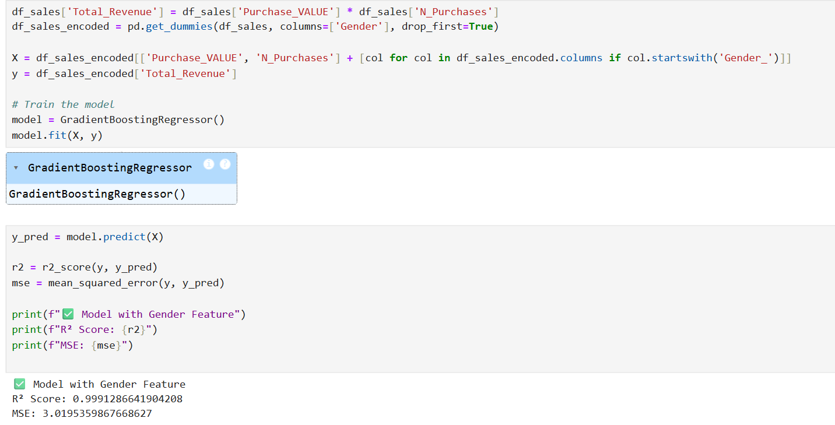


Slide 9


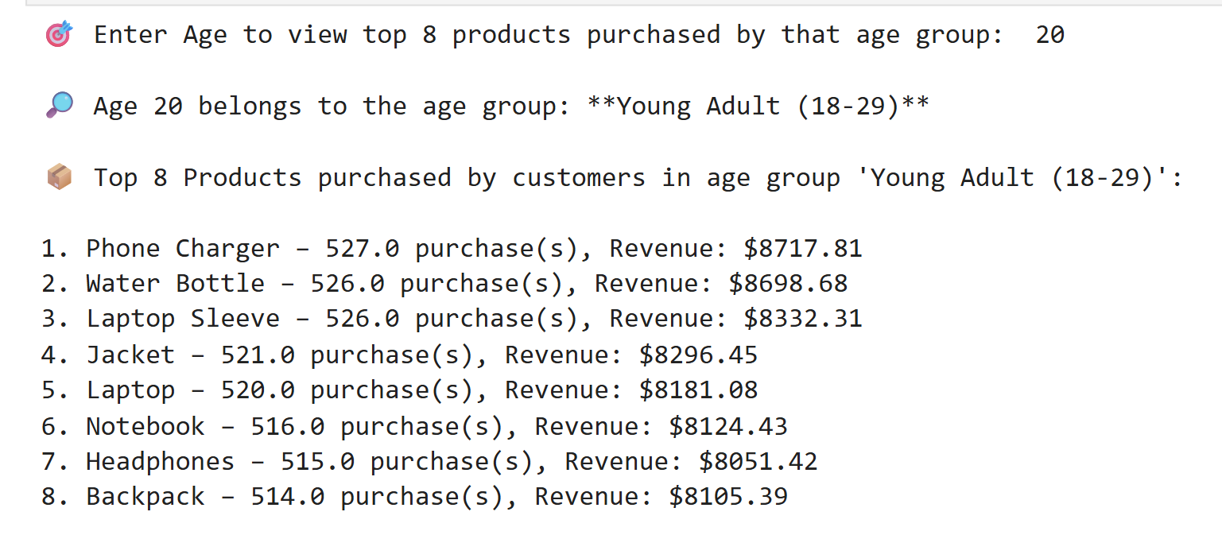


Slide 10

Model Prediction Using Unseen Data
Why Test on Unseen Data?
To evaluate model performance in Real-world conditions
Prevent overfitting by checking how the model generalizes.
Ensure predictions are reliable for future customer data.
Split the dataset into training and testing sets.
Applied the trained XGBoost model to unseen customer records (test set).

Slide 11
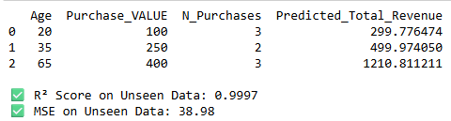

Model Prediction Using Unseen Data

Slide 12


Conclusion
While cleaning the data, we ensured consistency by replacing missing values and decoding categories, which helped improve model performance.
Preprocessing allowed us to focus on meaningful features, making the dataset more suitable for analysis and modeling.
Visualizations provided deep insights into customer behavior and revenue trends.
XGBoost proved effective in predicting revenue, even on unseen data.

Slide 13





